Slide 1
BLOCKING AND DEADLOCKS

Slide 2
Overview
At the end of this presentation you’ll come to know:
What is blocking?
What are its cause?
Identifying blocking
Avoidance
Scenarios and Resolutions

Slide 3
What is blocking?
SQL Server blocking occurs when one connection (user process or application process) places a lock on a table (or a number of rows) and a second connection attempts to read or modify the data under the lock.
The term "connection" refers to a single logged-on session of the database

Slide 4
Causes
SPID lock holding onto a set of resources for an extended period of time (Long running queries)
SPID lock never releasing the resources
Cancelling queries
Client server deadlock

Slide 5
How to identify blocking?
Identify the SPID (Session ID) at the head of the blocking chain and the SQL Statement.
- DBCC INPUTBUFFER(<spid>)
Find the transaction nesting level and process status of the blocking SPID.
      - @@TRANCOUNT
      SELECT open_tran FROM master.sys.sysprocesses WHERE SPID=<blocking SPID number>

Slide 6
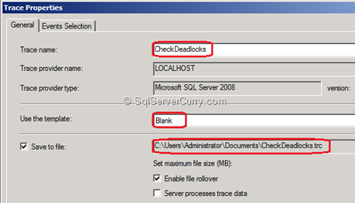
Research
Getting the Profiler Trace information

Slide 7
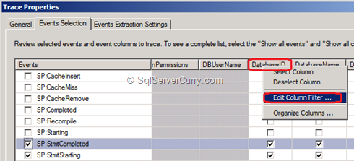

Slide 8
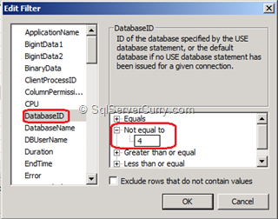

Slide 9
SELECT
db.name DBName,
tl.request_session_id,
wt.blocking_session_id,
OBJECT_NAME(p.OBJECT_ID) BlockedObjectName,
tl.resource_type,
h1.TEXT AS RequestingText,
h2.TEXT AS BlockingTest,
tl.request_mode
FROM sys.dm_tran_locks AS tl
INNER JOIN sys.databases db ON db.database_id = tl.resource_database_id
INNER JOIN sys.dm_os_waiting_tasks AS wt ON tl.lock_owner_address = wt.resource_address
INNER JOIN sys.partitions AS p ON p.hobt_id = tl.resource_associated_entity_id
INNER JOIN sys.dm_exec_connections ec1 ON ec1.session_id = tl.request_session_id
INNER JOIN sys.dm_exec_connections ec2 ON ec2.session_id = wt.blocking_session_id
CROSS APPLY sys.dm_exec_sql_text(ec1.most_recent_sql_handle) AS h1
CROSS APPLY sys.dm_exec_sql_text(ec2.most_recent_sql_handle) AS h2

Slide 10
Avoidance
Query timeout
Lock timeout
- SET LOCK_TIMEOUT timeout_period
Bounded connection
Checking upon the number of open transactions
- DBCC opentran

Slide 11
Common Blocking Scenarios and Resolutions
1) Blocking Caused by a Normally Running Query with a Long Execution Time
Resolution:
- to look for ways to optimize the query.

Slide 12
  2) Blocking Caused by an Orphaned Connection
  Resolution:
  If the client application has disconnected without appropriately cleaning up its resources, you can terminate the SPID(connection) by using the KILL command.
  Ex: KILL 9 [where 9 is the SPID]

Slide 13
3) Blocking Caused by a SPID Whose Corresponding Client Application Did Not Fetch All Result Rows to Completion
Resolution:
The application must be re-written to fetch all rows of the result to completion.

Slide 14
4) Blocking Caused by a Distributed Client/Server Deadlock
Resolutions:
Query Timeout
Bound Connections

Slide 15
5) Blocking Caused by a Sleeping SPID That Has Lost Track of the Transaction Nesting Level
Resolutions:
This can occur if the application experiences a query timeout, or issues a cancel without also issuing the required number of ROLLBACK and/or COMMIT statements.

Slide 16
Summary
Blocking happens when one connection from an application holds a lock and a second connection requires a conflicting lock type.
Resolutions to overcome blocking scenarios

Slide 17
Research
Proper indexes – A solution to avoid blocking.
Profiler – identify blocking

Slide 18
References
http://www.sql-server-performance.com/2006/blocking/
http://support.microsoft.com/kb/224453
http://msdn.microsoft.com/en-us/library/aa178087(v=SQL.80).aspx

Slide 19
DEADLOCKS

Slide 20
Overview
How blocking leads to deadlocks?
What is a deadlock?
What happens then?
Capturing deadlocks
Resources that may cause it
Minimizing deadlocks

Slide 21
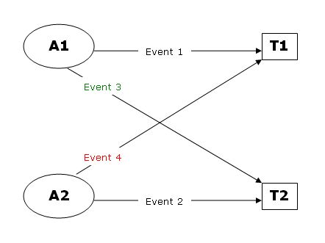
Blocking - Deadlocks
Blocking escalates to a bigger problem – DEADLOCKS

Slide 22
Deadlock
A deadlock occurs when two or more tasks permanently block each other by each task having a lock on a resource which the other tasks are trying to lock

Slide 23
What happens then?
SQL Server chooses one of the processes as the deadlock victim and aborts it.
It is rolled back and a 1205 error notification is sent back to the user.
Your server command (process id N) was deadlocked with another process and has been chosen as deadlock victim. Re-run your command.
This process is taken care by the LOCK MONITOR

Slide 24
Choosing the deadlock victim
Deadlock priority – lowest priority process chosen as the victim
      SET DEADLOCK_PRIORITY { LOW | NORMAL | HIGH | <numeric-priority> | @deadlock_var | @deadlock_intvar } <numeric-priority> ::= { -10 | -9 | -8 | … | 0 | … | 8 | 9 | 10 }
Rollback cost
    – in case of equal priority, this is taken into consideration
    - the process with the lowest rollback cost is chosen.

Slide 25
Resources that can cause Deadlock
Locks
Worker Threads
Memory

Slide 26
Deadlock Detection
Default interval time (5 secs) reduced to 100ms by the database engine in the event of occurrence of a deadlock
Resolving done by choosing the deadlock victim and raising the exception
Resources are then to be EXPLICITLY released.

Slide 27
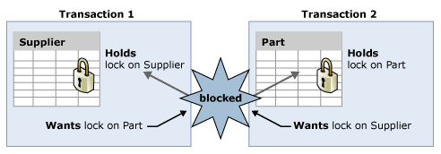
An Example..

Slide 28
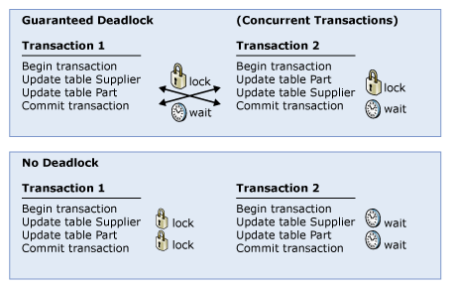
Minimizing Deadlocks (1)
Access objects in the same order.

Slide 29
Minimizing Deadlocks (2)
Avoid user interaction
Keep transactions short and in one batch.
Use a lower isolation level.
Use a row versioning-based isolation level.
  -Set READ_COMMITTED_SNAPSHOT ON to enable read-committed transactions to use row versioning.
  -Use snapshot isolation.
Use bound connections.

Slide 30
Capturing Deadlocks
Deadlock Graphs - an output of information regarding the sessions and resources that were involved in a deadlock.
Ways:
      - Trace flags
      - Trace Profiler

Slide 31
Capturing Deadlocks(2)
Trace flags
Flag 1204(SS 2000)
Flag 1222(SS 2005)
      - outputs the deadlock graph info into the error log.
      - makes it easier to analyse the deadlock
Set ON by
      DBCC TRACEON(1204,-1)
      Properties->General->Startup settings ->T-1222
      - outputs the deadlock graph info into the error log.
      - makes it easier to analyse the deadlock

Slide 32
Capturing Deadlocks(3)
SQL Profiler
Select the deadlock graph event under the Locks events
Info saved as an xdl file.
Can also export script and access the deadlocks on the server side via:
    SP_TRACE_*

Slide 33
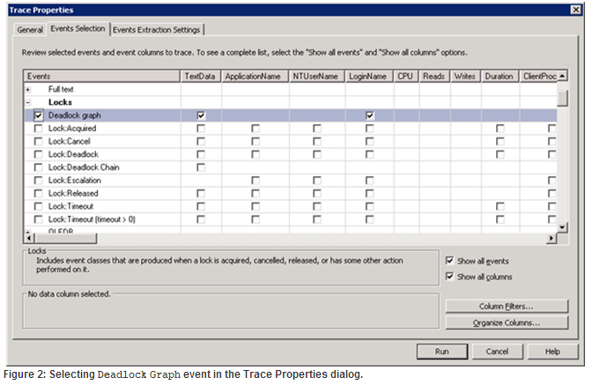

Slide 34
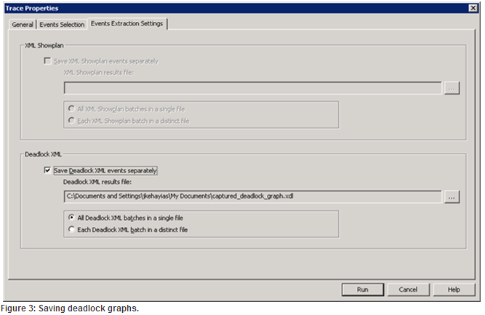

Slide 35
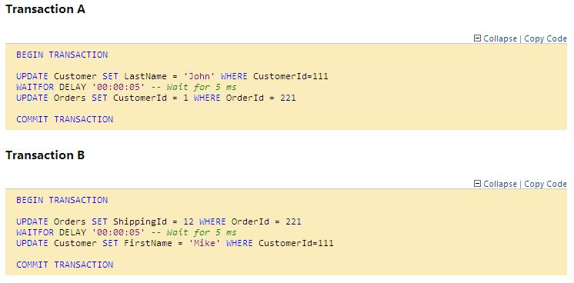
Example ..

Slide 36


Slide 37
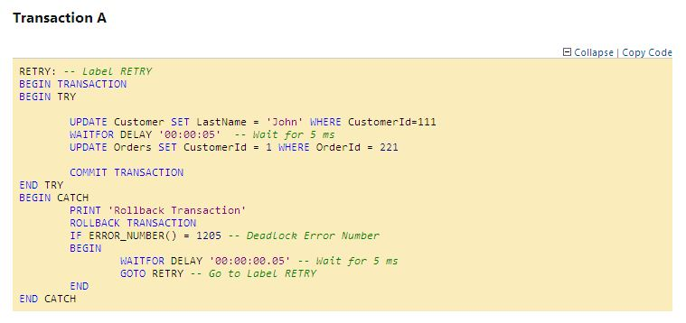

Slide 38
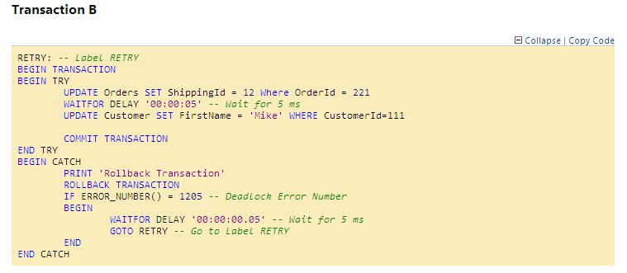

Slide 39


Slide 40
References
http://www.simple-talk.com/sql/database-administration/handling-deadlocks-in-sql-server/
http://www.codeproject.com/Articles/42547/SQL-SERVER-How-To-Handle-Deadlock
http://msdn.microsoft.com/en-us/library/ms188246.aspx

Slide 41
Thank You ☺

